Slide 1


US airport TSA complaint analysis
What to look out for?

Slide 2
APPROACH :
The complaints data was linked to airport geo info, then imported into python and power BI to do analysis and generate visual
Audience:
General air travelers who is using US airport.
Resource:
Complaints by airport.csv
Complaints by category.csv
Complaints by subcategory.csv
Iata-icao.csv

Slide 3
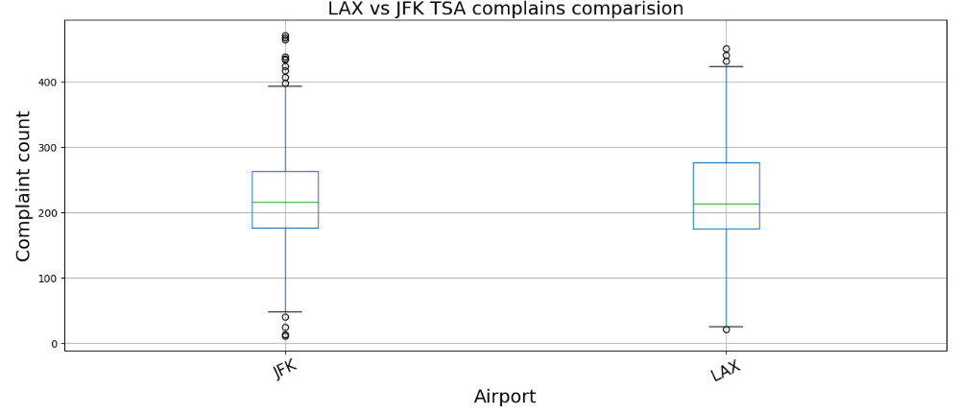
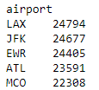
The busiest airports received most complaints
US airport with most complaints
Data source: complaints-by-airport.csv
Box plot created in python

Slide 4
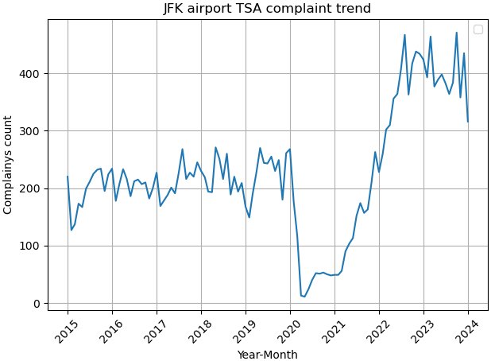
More complaints now than per-covid era.
Covid travel ban
Data source: complaints-by-airport.csv
Time series trend chart created in python

Slide 5
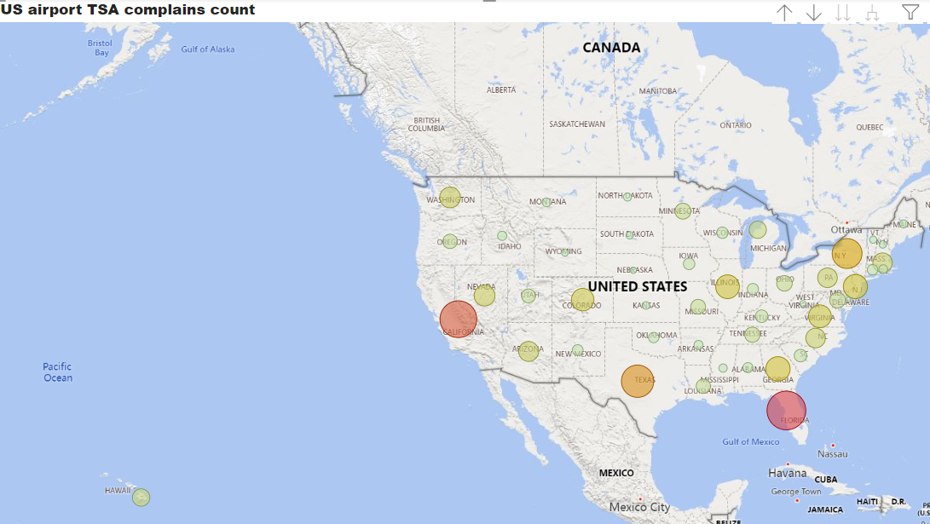
Airports in Florida also ranked top on complaint counts
Bubble size represent complaints count
Data source: complaints-by-category.csv
Choropleth Map chart created in power BI

Slide 6
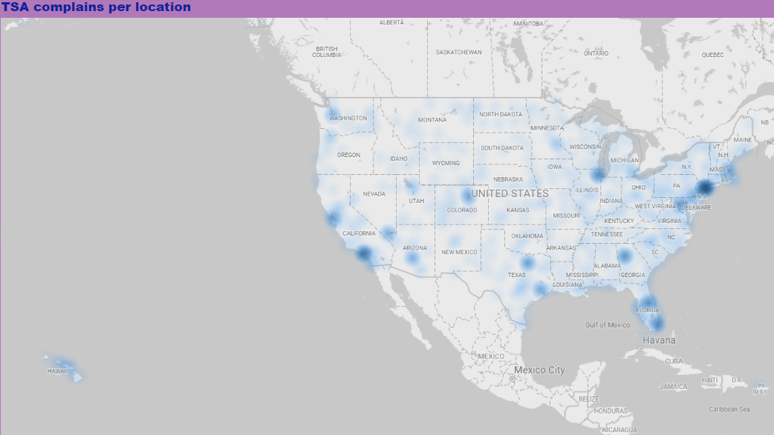
All high traffic airports receive high count of complaints.
Data source: complaints-by-category.csv
Heat Map chart created in power BI

Slide 7
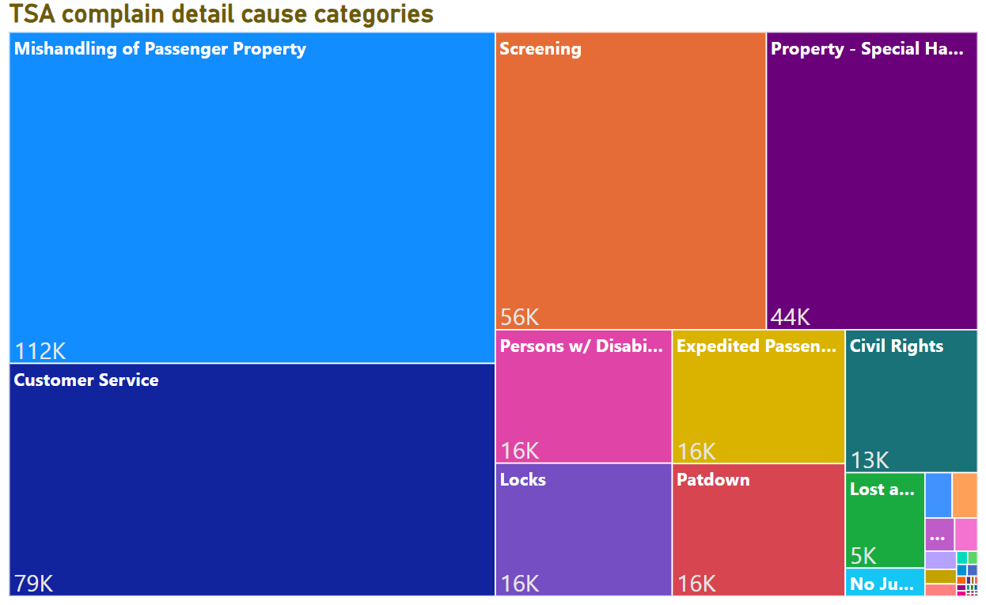
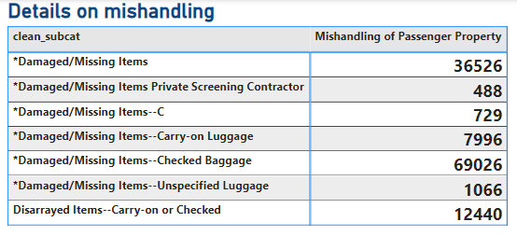
Mishandling of traveler items caused most complaints
Data source: complaints-by-subcategory.csv
Tree map and table created in power BI

Slide 8
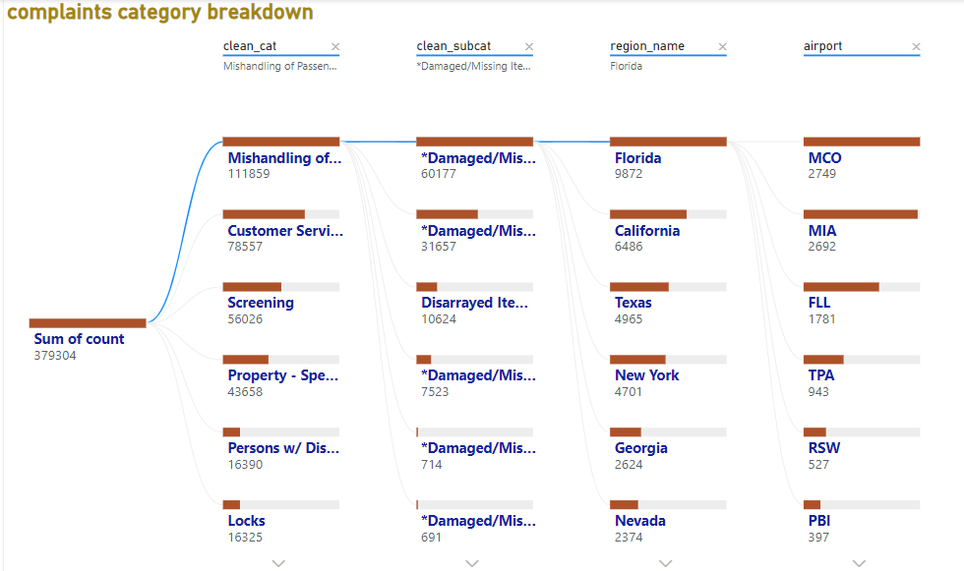
Top 3 regions for damaged items: FL, CA and TX
Data source: complaints-by-subcategory.csv
Decomposition created in power BI

Slide 9
Summary and Call of Actions:
Passenger’s item damage is a systematic issue across US airport.
Busy airports has more complaints raised.
Proactively protect your luggage!!

Slide 10
Power BI Chart link
Tree map, table and decomposition :
https://app.powerbi.com/groups/me/reports/1385fa82-e2f5-4e3d-aadb-3ddf9753171b/4654f5f10eb392f47bca?bookmarkGuid=b99ce63d-07b6-4584-9d30-0d18f014766d&bookmarkUsage=1&ctid=26feded2-a083-4777-8052-06ad5ef53556&portalSessionId=ceace57e-4e92-49d8-a2af-e3e732c031ef&fromEntryPoint=export
Choropleth Maps
https://app.powerbi.com/groups/me/reports/4f09fd0f-a319-495f-92fc-cef5f4be6a47/84e337a9f193c65eb028?bookmarkGuid=206d23d6-9715-43d6-84e1-0b79d73e4f6a&bookmarkUsage=1&ctid=26feded2-a083-4777-8052-06ad5ef53556&portalSessionId=ceace57e-4e92-49d8-a2af-e3e732c031ef&fromEntryPoint=export

